Slide 1
Relational Data Model

Slide 2
History Of Relational Data Model
“An IBM scientist E.F. Codd proposed the relational data model in 1970.
At that time most database systems were based on one of two older data models (the hierarchical model and the network model); the relational model revolutionized the database field and largely replaced these earlier models.

Slide 3
Today, the relational model is by far the dominant data model and is the foundation for the leading DBMS products, including IBM's DB2 family, Informix, Oracle, Sybase, Microsoft's Access and SQLServer, FoxBase, MySQL, and Paradox.

Slide 4
Relational Data Model
The RDM is popular due to its two major strengths and they are:
Simplicity
Strong Mathematical Foundation

Slide 5
Relational Data Model
The RDM is simple, why, there is just one structure and that is a relation or a table.

Slide 6
Relational Data Model
Secondly, it has a strong mathematical foundation that gives many advantages, like:
Anything included/defined in RDM has got a precise meaning since it is based on mathematics, so there is no confusion.
If we want to test something regarding RDM we can test it mathematically, if it works mathematically it will work with RDM.

Slide 7
Relational Data Model
stID | stdName | StdClassName | dOb | Gender
1 | M. Sahil | MCS | 19/06/84 | M
2 | M. Ubaid | BCS | 25/07/86 | M
3 | Abdullah | MCS | 24/01/83 | M
4 | Shaista A. | BCS | 04/05/84 | F
5 | M. Ahmed | MCS | 05/05/84 | M
6 | M. Jawaid | MSC | 06/08/84 | M

Slide 8
Comparative Terms
Table Schema -> Table description
Entity -> Table –> Relation
Instance -> Tuple –> Row
Attribute -> Column
Domain –> Value Set

Slide 9
Properties of Relation
Each cell of a table contains atomic/single value
A cell is the intersection of a row and a column, so it represents a value of an attribute in a particular row.
The property means that the value stored in a single cell is considered as a single value.

Slide 10
Properties of Relation
Each column has a distinct name; the name of the attribute it represents
Each column has a heading that is basically the name of the attribute that the column represents. It has to be unique, that is, a table cannot have duplicated column/attribute names.

Slide 11
Properties of Relation
The values of the attributes come from the same domain
Each attribute is assigned a domain along with the name when it is defined. The domain represents the set of possible values that an attribute can have.

Slide 12
Properties of Relation
The order of the columns is immaterial
If the order of the columns in a table is changed, the table still remains the same. Order of the columns does not matter.
The order of the rows is immaterial
As with the columns, if rows’ order is changed the table remains the same.

Slide 13
Properties of Relation
Each row/tuple/record is distinct, no two rows can be same
Two rows of a table cannot be same. The value of even a single attribute has to be different that makes the entire row distinct.

Slide 14
Properties of Relation
There are three components of the RDM, which are, construct (relation), manipulation language (SQL) and integrity constraints (two).

Slide 15
Relation Keys
The concept of key and all different types of keys is applicable to relations as well.
We will now discuss the concept of foreign key in detail, which will be used quite frequently in the RDM.

Slide 16
Relation Keys
Foreign Key An attribute of a table B that is primary key in another table A is called as foreign key.
For Example,
Consider the following two tables EMP and DEPT:
DEPT (depId, depName, numOfEmp, depLocation)
EMP (empId, empName, qual, depId)

Slide 17
Requirements/Constraints of Foreign Key
There can be more than zero, one or multiple foreign keys in a table, depending on how many tables a particular table is related with.
For example
in the above example the EMP table is related with the DEPT table, so there is one foreign key depId whereas DEPT table does not contain any foreign key.
Similarly, the EMP table may also be linked with DESIG table storing designations, in that case EMP will have another foreign key and alike.

Slide 18
Requirements/Constraints of Foreign Key
The foreign key attribute and the one present in another relation as primary key can have different names, but both must have same domains.
In DEPT, EMP example, both the PK and FK have the same name; they could have been different, it would not have made any difference however they must have the same domain.

Slide 19
Requirements/Constraints of Foreign Key
Foreign key it self value is not required to be unique.

Slide 20
Integrity Constraint
Two main types
Entity Integrity Constraint
Referential Integrity Constraint

Slide 21
Entity Integrity Constraint
Primary Key cannot have null value ( Simple or Composite)
Its so important, so common, so frequent that is has become the part of the data model.
Notes:
It is impose/controlled by RDBM software it self. If you make a primary key (simple or composite) RDBMS make it sure that you don’t enter NULL or Duplicate value of primary key.

Slide 22
Referential Integrity Constraint
Foreign key either can have NULL or matches with a value in home its home relation
Its so important, so common, so frequent that is has become the part of the data model.
Notes:
It is impose/controlled by RDBM software it self. If you make an attribute a foreign key, you relate an attribute with another relation’s primary key in it’s home relation, now DBMS will make sure you doesn’t enter a foreign key that does not math with the primary key of its home relation.

Slide 23
Other Constraints
Null Constraints
Default Value
Domain Constraint and (check constraint)
UNIQUE

Slide 24
Significance of Constraints
Constraints help to maintain the correctness, validity or integrity of the database.

Slide 25
RDM COMPONENTS
STRUCTURE
CONTRAINTS
MAINUPLATION LANGUAGE

Slide 26
DESIGNING LOGICAL MODEL
Logical data base design is obtained from conceptual database design.
We make Conceptual design using E-R Data Model because this is semantically rich.
Logical design required Relational Data Model, that we have discussed so far.
Now we transform Conceptual design to Logical design.
Involves transformation of E-R data model into relational data model

Slide 27
Transforming Rules
Following are the transforming rules for converting conceptual database into logical database design:
manually
CASE tools

Slide 28
Mapping Entity Types
Each regular entity type (ET) is transformed straightaway into a relation
Primary key of the entity is declared as Primary key of relation and underlined. Simple attributes of ET are included into the relation.

Slide 29
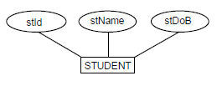


Slide 30
Mapping Entity Types
Composite Attributes
Now in relational data model composite attributes are treated differently. Since tables can contain only atomic values composite attributes need to be represented as a separate relation.

Slide 31
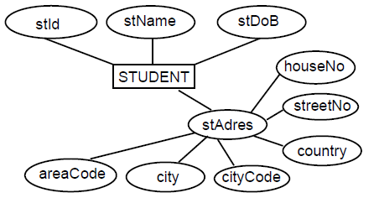
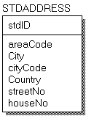

Slide 32
Mapping Entity Types
Multi-valued Attributes
These are those attributes which can have more than one value.
An Entity type with a multi-valued attribute is transformed into two relations One contains the entity type and other simple attributes whereas the second one has the multi-valued attribute. In this way only single atomic value is stored against every attribute.
The Primary key of the second relation is the primary key of first relation and the attribute value itself. So in the second relation the primary key is the combination of two attributes.

Slide 33
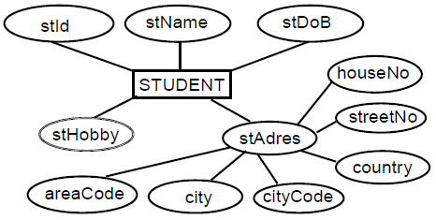
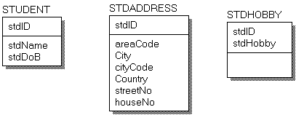

Slide 34
Mapping Relationships
Binary Relationships
Unary Relationships
Relationships in relational data model are mapped according to their degree and cardinalities. It means before establishing a relationship there cardinality and degree is important.

Slide 35
Binary Relationships
One to One
One to Many
Many to Many

Slide 36
One to Many
The relationship in this particular case will be implemented by placing the PK of the entity type (or corresponding relation) against one side of relationship will be included in the entity type (or corresponding relation) on the many side of the relationship as foreign key (FK).
By declaring the PK-FK link between the two relations the referential integrity constraint is implemented automatically, which means that value of foreign key is either null or matches with its value in the home relation.

Slide 37
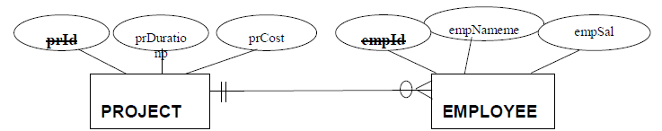
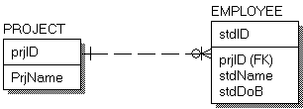

Slide 38
Minimum Cardinality:
ONE to MANY Mandatory : in that case the minimum cardinality has to be one. FK not NULL
ONE TO MANY OPTIONAL: FK can be NULL.
Integrity constraint applied on both

Slide 39
Many to Many Relationship
In this type of relationship one instance of first entity can be mapped with many instances of second entity.
Similarly one instance of second entity can be mapped with many instances of first entity type.
In many to many relationship a third table is created for the relationship, which is also called as associative entity type.
Primary keys of the participating entity types are used as primary key of the third table.

Slide 40
StdName
Crs_Name
FatherName
Crs_Code
Reg_No
STUDENT
COURSE
Crs_Code
STUDENT
COURSE
Reg_No
COURSE

Slide 41
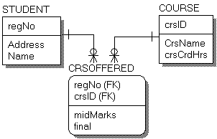

Slide 42
One to One Relationship
In which one instance of first entity type is mapped with one instance of second entity type and also the other way round.

Slide 43
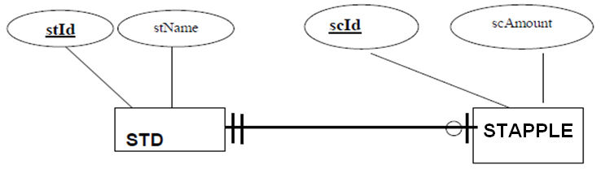


Slide 44
One to One Relationship
One to One Optional: UNIQUE and NULL
One to One Mandatory: UNIQUE and NOT NULL

Slide 45
Unary Relationship
These are the relationships, which involve a single entity. These are also called recursive relationships.
the PK of same entity type is used as foreign key in the same relation and obviously with the different name since same attribute name cannot be used in the same table.

Slide 46
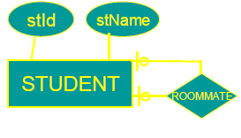
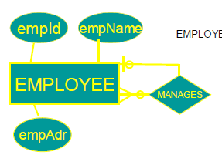

Slide 47
